Slide 1
The Short-Run Trade-off between Inflation and Unemployment
CHAPTER
35

Slide 2
Look for the answers to these questions:
How are inflation and unemployment related in the short run? In the long run?
What factors alter this relationship?
What is the short-run cost of reducing inflation?
Why were U.S. inflation and unemployment both so low in the 1990s?

Slide 3
Introduction
In the long run, inflation & unemployment are unrelated:
The inflation rate depends mainly on growth in the money supply.
Unemployment (the “natural rate”) depends on the minimum wage, the market power of unions, efficiency wages, and the process of job search.
In the short run, society faces a trade-off between inflation and unemployment.
Notes:
The last statement is one of the Ten Principles in Chapter 1.

Slide 4
The Phillips Curve
Phillips curve, PC:
Short-run trade-off between inflation and unemployment
1958: A.W. Phillips
Nominal wage growth was negatively correlated with unemployment in the U.K.
1960: Paul Samuelson & Robert Solow
Negative correlation between U.S. inflation & unemployment
Named it “the Phillips Curve.”

Slide 5
Deriving the Phillips Curve, PC
Suppose P = 100 this year.
The following graphs show two possible outcomes for next year:
Aggregate demand low, small increase in P (i.e., low inflation), low output, high unemployment.
Aggregate demand high, big increase in P (i.e., high inflation), high output, low unemployment.
Notes:
“Suppose P = 100 this year” provides an anchor to the analysis in the graphs on the following slide.
At this point, remind students that output and unemployment are negatively related over business cycles (one of the “three facts about economic fluctuations” from the chapter entitled “Aggregate Demand and Aggregate Supply”).

Slide 6
Deriving the Phillips Curve
A. Low aggregate demand, low inflation, high u-rate
P
inflation
SRAS
B
B
5%
105
A
103
A
AD₂
3%
PC
AD₁
Y₁
Y₂
Y
4%
6%
u-rate
B. High aggregate demand, high inflation, low u-rate
Notes:
6
Assume P = 100 this year.
If aggregate demand next year is low—reflecting, for example, slow money growth—then outcome A will occur next year. In outcome A, P = 103 next year, so the inflation rate from this year to next equals 3%. Output (Y₁) is relatively low, so unemployment is relatively high at 6%.
Instead, if aggregate demand next year is high—reflecting, for example, rapid money growth—then outcome B will occur next year. In outcome B, P = 105 next year, so the inflation rate from this year to next equals 5%. Output (Y₂) is higher, so unemployment is lower (4%).

Slide 7
The Phillips Curve: A Policy Menu?
Since fiscal and monetary policy affect aggregate demand,
The PC appeared to offer policymakers a menu of choices:
Low unemployment with high inflation
Low inflation with high unemployment
Anything in between
1960s: U.S. data supported the PC
Many believed the PC was stable and reliable

Slide 8
Evidence for the Phillips Curve?
Inflation rate (% per year)
During the 1960s, U.S. policymakers opted for reducing unemployment at the expense of higher inflation
68
66
67
62
65
1961
64
63
Unemployment rate (%)
Notes:
The data almost perfectly trace out a downward-sloping Phillips curve.
But what’s important here is not just the negative slope, but the economy’s movement over the years:
Fiscal policy was expansionary, in part to finance the Vietnam war. To keep interest rates low, the Fed made monetary policy expansionary as well. As a result, aggregate demand grew over the 1960s.
You can see this if you follow the points year by year: inflation gradually creeps up while unemployment is falling, which is exactly what was depicted on the graphs we used to derive the Phillips curve.

Slide 9
The Vertical Long-Run Phillips Curve
1968: Milton Friedman and Edmund Phelps
Argued that the tradeoff was temporary
Based on the classical dichotomy and the vertical LRAS curve
Natural-rate hypothesis:
The claim that unemployment eventually returns to its normal or “natural” rate, regardless of the inflation rate
Notes:
In the face of what many considered overwhelming evidence for the stability of the downward-sloping Phillips curve, Friedman and Phelps (working separately) boldly asserted that any tradeoff would be purely temporary.
Their logic? The Classical Dichotomy and the vertical LRAS curve.

Slide 10
The Vertical Long-Run Phillips Curve
In the long run, faster money growth only causes faster inflation.
P
inflation
LRAS
LRPC
high infla-tion
P₂
P₁
AD₂
low infla-tion
AD₁
Y
u-rate
Natural rate of output
Natural rate of unemployment
Notes:
10
The greater the expansion of the money supply, the faster AD will shift to the right, resulting in a larger increase in prices—i.e., higher inflation.
But this higher inflation will not produce lower unemployment: in the long run, unemployment always goes to its natural rate whether inflation is high or low. In the long run, faster money growth only causes faster inflation.

Slide 11
Reconciling Theory and Evidence
Evidence (from 1960s):
PC slopes downward
Theory (Friedman and Phelps):
PC is vertical in the long run.
Friedman and Phelps, bridge the gap between theory and evidence
Introduced a new variable: expected inflation – a measure of how much people expect the price level to change

Slide 12
The Phillips Curve Equation
Natural rate of unemp.
Unemp. rate
–
a
Actual inflation
–
Expected inflation
=
Short run
The Fed can reduce u-rate below the natural u-rate by making inflation greater than expected.
Long run
Expectations catch up to reality, u-rate goes back to natural u-rate whether inflation is high or low.
Notes:
This equation is essentially the equation for aggregate supply introduced in the “aggregate demand and aggregate supply” chapter.
The coefficient a is a positive number that measures the relationship between unexpected inflation and deviations of unemployment from its natural rate: A 1% increase in inflation causes the unemployment rate to fall by a (for given values of the natural rate and expected inflation).
Point out to students that this equation—and its coefficient a—are very similar to the equation for the aggregate supply curve in the chapter “Aggregate Demand and Aggregate Supply.”
If the Fed wants to reduce unemployment below the natural rate, it has to surprise people with higher-than-anticipated inflation. The result will be lower unemployment—but only until people adjust their expectations to the new reality of higher inflation.
Eventually, expectations catch up with reality—i.e., people see that inflation is higher than they’d expected, so they adjust their expectations upward.

Slide 13
How Expected Inflation Shifts the PC
Initially, expected & actual inflation = 3%, unemployment = natural rate (6%).
Fed makes inflation 2% higher than expected, u-rate falls to 4%.
In the long run, expected inflation increases to 5%, PC shifts upward, unemployment returns to its natural rate.
inflation
LRPC
B
C
5%
3%
A
PC₂
PC₁
4%
6%
u-rate
Notes:
13
When people adjust their inflation expectations upward, then the PC shifts up: each value of the u-rate is associated with a higher inflation rate.
Of course, we can extrapolate this: Suppose the Fed wants to PERMANENTLY keep unemployment at 4%. It must continually raise inflation above expectations. Expectations will keep adjusting upward, so the Fed will have to keep raising the inflation rate faster than expectations are adjusting. Inflation spirals upward as a result of the attempt to keep unemployment at 4%.
Before long, people will come to expect not only higher inflation but ever-increasing inflation, and they will factor this into their contracts. It will be extremely difficult for the Fed to continue this game.
Ultimately, unemployment has to return to the natural rate, yet the economy will end up with something approaching hyperinflation and the costs it imposes on society.

Slide 14
Active Learning 1 A numerical example
Natural rate of unemployment = 5% Expected inflation = 2% In PC equation, a = 0.5
Plot the long-run Phillips curve.
Find the u-rate for each of these values of actual inflation: 0%, 6%. Sketch the short-run PC.
Suppose expected inflation rises to 4%. Repeat part B.
Instead, suppose the natural rate falls to 4%. Draw the new long-run Phillips curve, then repeat part B.
Notes:
For many students, working a concrete numerical example helps make the concepts clearer. This exercise leads students to see for themselves how the Phillips curve shifts in response to changes in expected inflation and the natural rate of unemployment.
If you would like to get through the chapter more quickly, you can delete Part D of the question from this slide (and the corresponding parts of the answers on the next slide).

Slide 15
Active Learning 1 Answers
LRPC_{D}
PC_{B}
LRPC_{A}
An increase in expected inflation shifts PC to the right.
PC_{D}
A fall in the natural rate shifts both curves to the left.
PC_{C}
Notes:
The subscript in each curve’s label refers to the corresponding part of the question. For example, the answer to part C is the downward-sloping dark red curve labeled PC_{C}.
Parts A and B comprise a benchmark, an initial set of LR and SR Phillips curves, against which we will compare
- the effects of an increase in expected inflation (Part C)
the effects of a fall in the natural rate (Part D)

Slide 16
The Breakdown of the Phillips Curve
Early 1970s: unemployment increased, despite higher inflation.
Inflation rate (% per year)
Friedman & Phelps’ explanation: expectations were catching up with reality.
73
69
70
71
68
72
66
67
62
65
1961
64
63
Unemployment rate (%)
Notes:
This chart adds a few additional years of data to the previous data chart.
From 1969 to 1973, inflation and unemployment BOTH INCREASE. People were adjusting their expectations of inflation upward, causing the Phillips curve to shift upward.
This is consistent with Friedman and Phelps’ work, which was looking increasingly convincing to economists and others.

Slide 17
Another PC Shifter: Supply Shocks
Supply shock:
An event that directly alters firms’ costs and prices
Shifting the AS and PC curves
Example: large increase in oil prices

Slide 18
How an Adverse Supply Shock Shifts the PC
SRAS shifts left, prices rise, output & employment fall.
P
inflation
SRAS₂
SRAS₁
B
P₂
B
P₁
A
A
PC₂
AD
PC₁
Y₂
Y₁
Y
u-rate
Inflation & u-rate both increase as the PC shifts upward.
Notes:
18
In the chapter “Aggregate Demand and Aggregate Supply,” students learned that adverse supply shocks—like oil price increases—shift the SRAS curve to the left, causing “stagflation” (falling output and rising prices).
We see here that adverse supply shocks also shift the short-run Phillips curve to the right and worsen the tradeoff between inflation and unemployment.

Slide 19
The 1970s Oil Price Shocks
The Fed chose to accommodate the first shock in 1973 with faster money growth.
Result: Higher expected inflation, which further shifted PC.
1979: Oil prices surged again, worsening the Fed’s tradeoff.
Oil price per barrel
1/1973
$ 3.56
1/1974
10.11
1/1979
14.85
1/1980
32.50
1/1981
38.00
Notes:
19
Data – the spot oil price of West Texas Intermediate
Original source: Dow Jones & Company
Where I found this data: http://research.stlouisfed.org/fred2/

Slide 20
The 1970s Oil Price Shocks
Inflation rate (% per year)
Supply shocks & rising expected inflation worsened the PC tradeoff.
81
75
74
80
79
78
77
73
76
1972
Unemployment rate (%)
Notes:
From 1973–75, inflation and unemployment both rise sharply, reflecting the upward shifts of the PC in response to the first supply shock and the Fed’s accommodating monetary policy.
During the mid-1970s, oil prices were relatively stable for a couple years, and the economy began its self-correction process with SRAS shifting down. On the graph on this slide, we see inflation coming down in 1976 and unemployment falling slightly as the economy starts to come out of the recession.
From 1976–79, it appears that policy was being used to push the economy up its new, higher Phillips curve to a point with lower unemployment but higher inflation.
In 1979, the revolution in Iran and renewed OPEC activity led to a second huge spike in oil prices, which further worsened the unemployment-inflation tradeoff. From 1979 to 1981, the graph shows both unemployment and inflation rising.

Slide 21
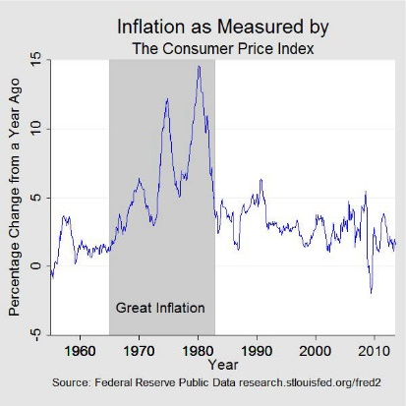

Slide 23
The Cost of Reducing Inflation
Disinflation:
A reduction in the inflation rate
To reduce inflation,
The Fed must slow the rate of money growth, which reduces aggregate demand
Short run:
Output falls and unemployment rises.
Long run:
Output & unemployment return to their natural rates.

Slide 24
Disinflationary Monetary Policy
Contractionary monetary policy moves economy from A to B.
Over time, expected inflation falls, PC shifts downward.
In the long run, point C: the natural rate of unemployment, lower inflation.
inflation
LRPC
A
B
C
PC₁
PC₂
u-rate
natural rate of unemployment
Notes:
24

Slide 25
The Cost of Reducing Inflation
Sacrifice ratio:
Percentage points of annual output lost per 1 percentage point reduction in inflation
Typical estimate: 5
To reduce inflation rate 1%, must sacrifice 5% of a year’s output.
Can spread cost over time: to reduce inflation by 6%, can either
sacrifice 30% of GDP for one year
sacrifice 10% of GDP for three years
Notes:
Disinflation requires enduring a period of high unemployment and low output.

Slide 26
Rational Expectations, Costless Disinflation?
Rational expectations:
Theory according to which people optimally use all the information they have
Including info about government policies, when forecasting the future
Early proponents: Robert Lucas, Thomas Sargent, Robert Barro
Implied that disinflation could be much less costly…

Slide 27
Rational Expectations, Costless Disinflation?
Suppose the Fed convinces everyone it is committed to reducing inflation.
Then, expected inflation falls, the short-run PC shifts downward.
Result: disinflations can cause less unemployment than the traditional sacrifice ratio predicts.

Slide 28
The Volcker Disinflation
Fed Chairman Paul Volcker
Appointed in late 1979 under high inflation & unemployment
Changed Fed policy to disinflation
1981–1984: Fiscal policy was expansionary
So Fed policy had to be very contractionary to reduce inflation.
Success: Inflation fell from 10% to 4%, but at the cost of high unemployment…
Notes:
By the end of the 1970s, the Phillips curve had shifted far to the right, substantially worsening the Fed’s short-run tradeoff between inflation and unemployment.
Volcker knew that monetary policy had to change.

Slide 29
The Volcker Disinflation
Disinflation turned out to be very costly
Inflation rate (% per year)
u-rate near 10% in 1982–83
81
80
1979
82
84
83
87
85
86
Unemployment rate (%)
Notes:
Volcker succeeded in bringing inflation down but at the cost of the deepest recession since the Great Depression.
Imagine a downward-sloping line going through the points from 1980 to 1982 or 1983. This imaginary line is the short-run Phillips curve at its highest level. The Fed pursued a policy that took the economy on a path very similar to that shown in the diagram a few slides back on a slide entitled “Disinflationary Monetary Policy.”

Slide 30
The Greenspan Era
1986: Oil prices fell 50%.
1989–90: Unemployment fell, inflation rose.
Fed raised interest rates, caused a mild recession
1990s: Unemployment and inflation fell.
2001:
Negative demand shocks created the first recession in a decade.
Policymakers responded with expansionary monetary and fiscal policy.

Slide 31
The Greenspan Era
Inflation rate (% per year)
Inflation and unemployment were low during most of Alan Greenspan’s years as Fed Chairman.
90
05
06
1987
2000
92
98
96
02
94
Unemployment rate (%)
Notes:
In this period, inflation and unemployment were lower and less variable than previous periods.
A few highlights:
1990–92: Rising unemployment that resulted from the first recession of this period.
1992–98: Unemployment falls without a corresponding increase in inflation; in fact, inflation edged lower.
1998–2000: Small increase in inflation while unemployment continues its downward march.
2001–2003: Rising unemployment following the second recession of this period
2003–2006: Expansionary fiscal and monetary policy reduce unemployment, at a cost of slightly higher inflation.

Slide 32
The Great Moderation
United States from the mid-1980s to the financial crisis in 2007.
Bernanke: three potential causes
1 structural change in the economy,
2. improved economic policies, and
3. good luck.

Slide 33
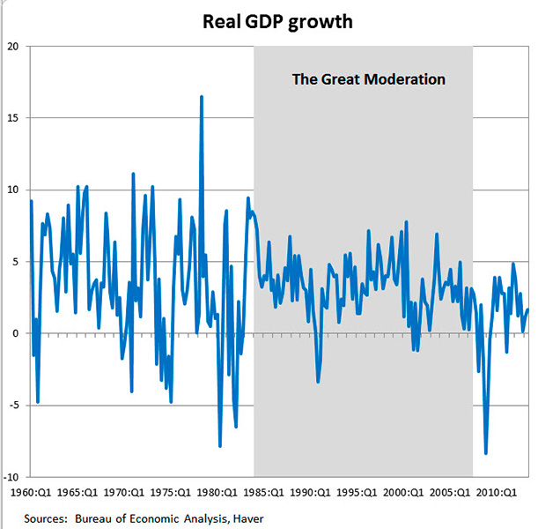

Slide 34
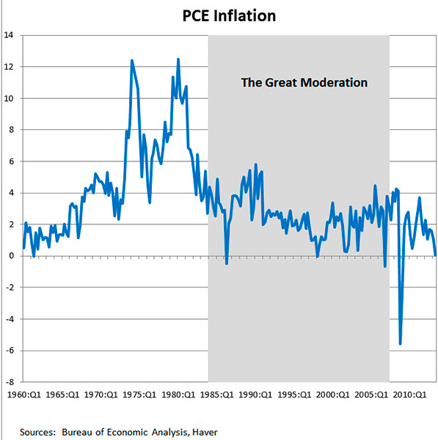

Slide 35
The Phillips Curve During the Financial Crisis
The early 2000s
Housing market boom turned to bust in 2006
Household wealth fell,
Millions of mortgage defaults and foreclosures
Heavy losses at financial institutions
Result:
Sharp drop in aggregate demand, steep rise in unemployment
Notes:
Ben Bernanke, Chair of FOMC, Feb 2006 – Jan 2014.
1995-2006: booming housing market: average U.S. house prices more than doubled
2006 – 2009: House prices fell by about one third (Declines in household wealth, Financial institutions – difficulties)
2007 to 2010, decline in AD
Raised unemployment (from below 5% to 10%)
Reduced the rate of inflation (from 3 to 1%)
2010 to 2015, slow recovery
Unemployment fell back to about 5%
Rate of inflation remained between 1 and 2%
The very low inflation of 2009 and 2010 did not reduced expected inflation
Expected inflation: steady at about 2%
Short-run Phillips curve relatively stable
The Fed, past 20 years - a lot of credibility in its commitment to keep inflation at 2%
Expected inflation and the position of the short-run Phillips curve reacted less to the dramatic short-run events

Slide 36
Phillips Curve During and after the Financial Crisis
2006-2009: The financial crisis caused aggregate demand to plummet, sharply increasing unemployment and reducing inflation.
Inflation rate (% per year)
2010-2015: A slow recovery reduced unemployment; inflation remained between 1 and 2%
Unemployment rate (%)
Notes:
In effect, the financial crisis moved the U.S. down along its Phillips curve; the recovery moved the U.S. back up it.

Slide 37
Conclusion
Theories in this chapter teach us that inflation and unemployment are:
Unrelated in the long run
Negatively related in the short run
Affected by expectations, which play an important role in the economy’s adjustment from the short-run to the long run
Notes:
The theories in this chapter come from some of the greatest economists of the 20th century.

Slide 38
Summary
The Phillips curve describes the short-run tradeoff between inflation and unemployment.
In the long run, there is no tradeoff: inflation is determined by money growth, while unemployment equals its natural rate.
Supply shocks and changes in expected inflation shift the short-run Phillips curve, making the tradeoff more or less favorable.

Slide 39
Summary
The Fed can reduce inflation by contracting the money supply, which moves the economy along its short-run Phillips curve and raises unemployment. In the long run, though, expectations adjust and unemployment returns to its natural rate.
Some economists argue that a credible commitment to reducing inflation can lower the costs of disinflation by inducing a rapid adjustment of expectations.

